Slide 1
K-16 Science at Edgewood: A Three School Collaboration

Slide 2
K-16 Science at Edgewood: A Three School Collaboration
Amy Schiebel, Ph.D.
Rachael Lancor, Ph.D.

Slide 3
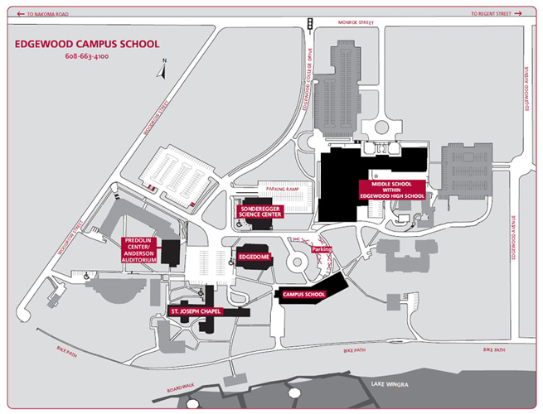
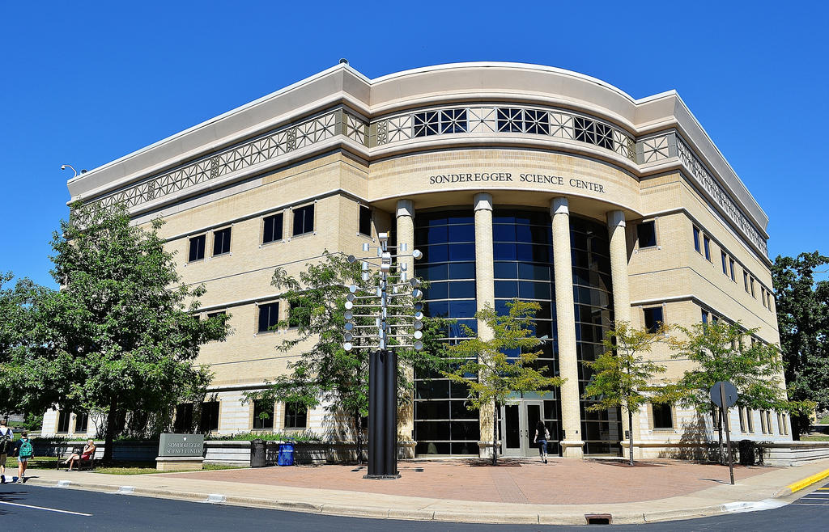
Setting
K-16 campus
Grade School
High School
College
K-16 Science Center

Slide 4
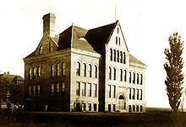
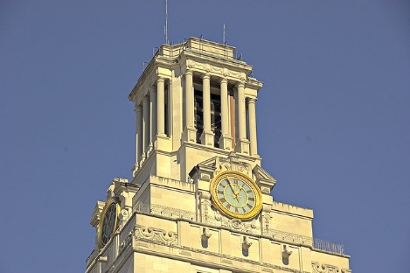
Funds of Knowledge
“…refer to the historically accumulated and culturally developed bodies of knowledge and skills essential for household or individual functioning and well-being”

Slide 5
Professional Development
Inquiry
Science Literacy
Science Standards
Etc.

Slide 6
Shared Resources

Slide 7
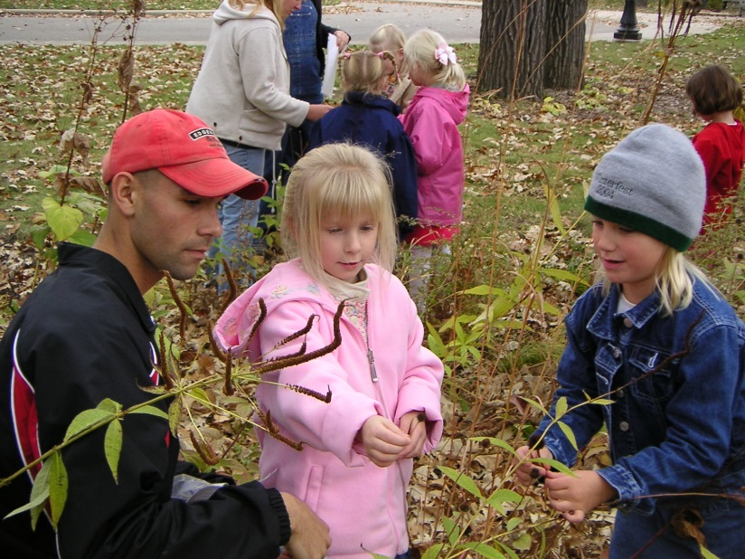
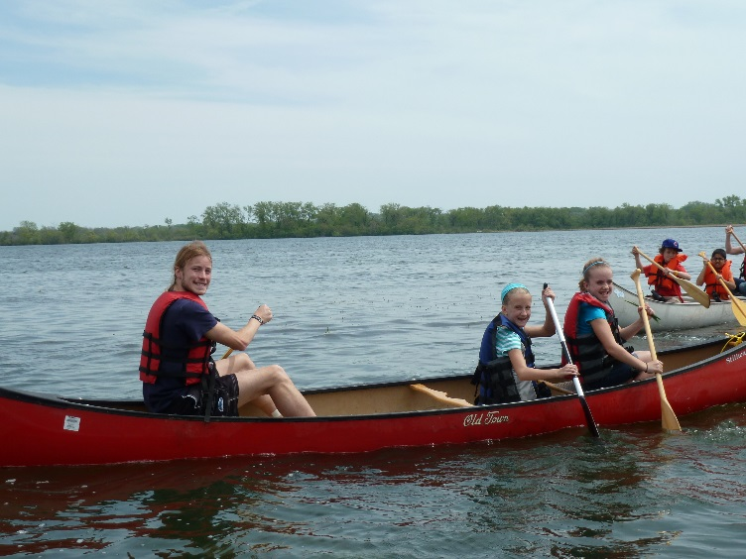
Special Event Collaborations
Class to Class

Slide 8
School to School Collaborations
Large Scale Events

Slide 9
Student Opportunity
Research

Slide 10
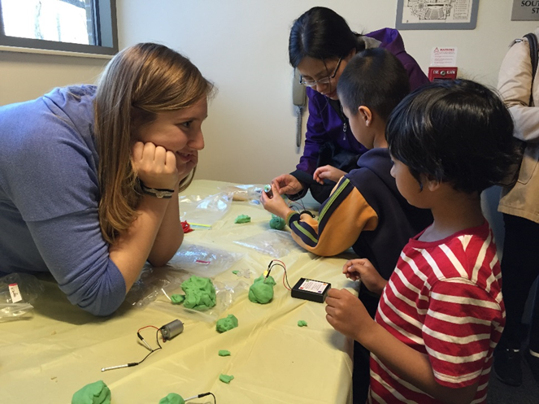
Community Engagement
Science Ambassadors
Family Science Night

Slide 11
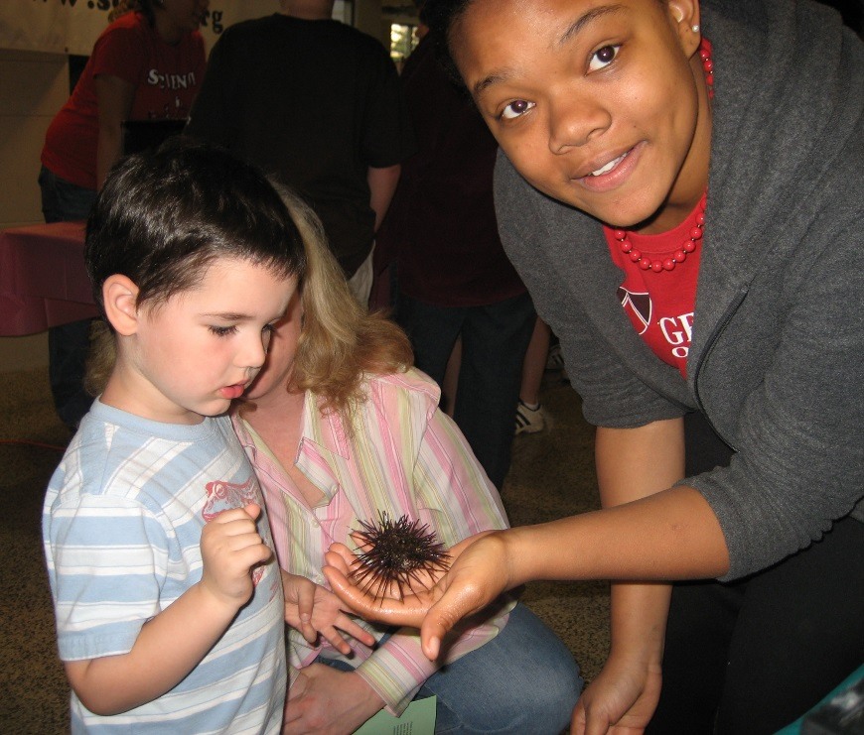
Learning and Doing Science Together
Edgewood K-16 Science

